Slide 1
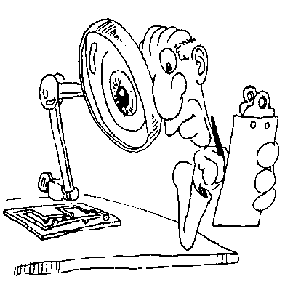
Experimental Design

Slide 2
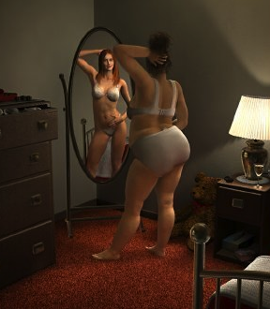
Considerations
Representativeness.
Is it like the real thing?
Control.
Cost and Effort.
Validity.

Slide 3
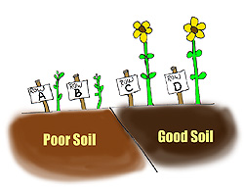
Considerations
Representativeness.
Control.
Can you manipulate something?
Cost and Effort.
Validity.

Slide 4
Considerations
Representativeness.
Control.
Cost and Effort.
Is it worth it?
Validity.

Slide 5
Considerations
Representativeness.
Control.
Cost and Effort.
Validity.
Is the experiment statistically appropriate?
Does it identify the real cause?
Does it measure what it is supposed to measure?
Will it generalise?

Slide 6
Scientific Method
Observation
Write down clearly
Hypothesis
Predictions
Experiment
Analysis
Conclusion
Report

Slide 7
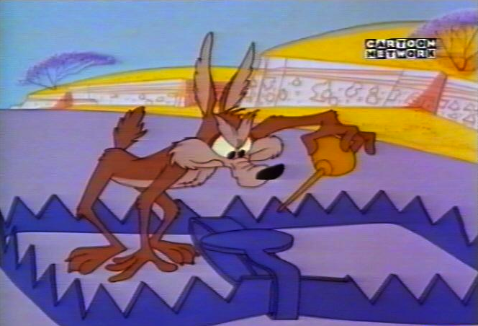
Variables
Independent.
What is varied (the treatment).
Dependent.
Control.
Random.
Confounding.

Slide 8
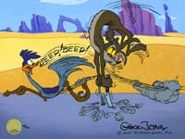
Variables
Independent.
Dependent.
What measure.
Control.
Random.
Confounding.

Slide 9
Variables
Independent.
Dependent.
Control.
Kept constant.
Random.
Confounding.

Slide 10
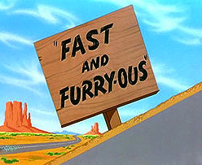
Variables
Independent.
Dependent.
Control.
Random.
Allow to fluctuate.
Confounding.

Slide 11
Variables
Independent.
Dependent.
Control.
Random.
Confounding.
- Factors that could also cause/mask the relationship between the independent and dependent variable.

Slide 12
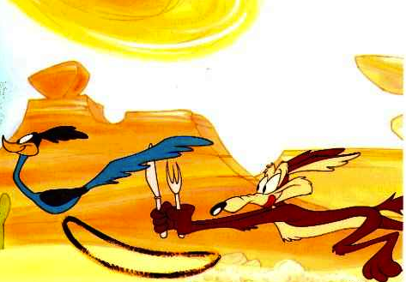
Types of Groups
Treatment group
Control group.

Slide 13
Assigning Groups
Independence of measures.
Pooling fallacy.
Litter effects.
Group effects.

Slide 14
Assigning Groups
Randomisation.
1 | 2 | 3 | 4

Slide 15
Examples of Experimental Design
One-way layout:
Effect of rock substrate on barnacle recruitment.

Slide 16
Examples of Experimental Design
Nested:

Slide 17
Examples of Experimental Design
Randomised Block Design.
- Block = delineated area or time period within which the environmental conditions are relatively homogenous.

Slide 18
Examples of Experimental Design
Repeated Measures Design.
Samples taken week 1, week 2, week 3 etc.

Slide 19
Potential Problems
Order effects.
Once an individual is tested it becomes a somewhat different individual.
A Solution:
TEST
TEST

Slide 20
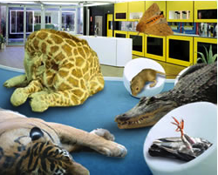
Potential Problems
Observer effects.
Observers presence changes the behaviour of the subject.
Solutions:
Hide.
Video Camera.

Slide 21
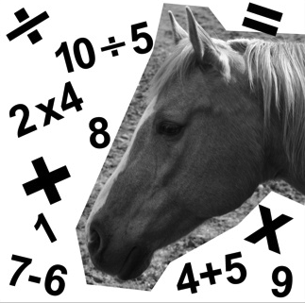
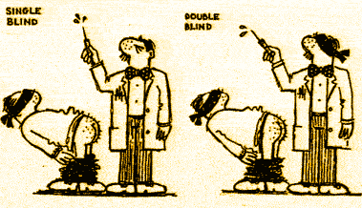
Potential Problems
Experimenter may accidentally skew results in favour of expected outcome.
A Solution:
- Double Blind Experiments
Experimenter Bias

Slide 22
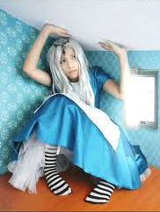
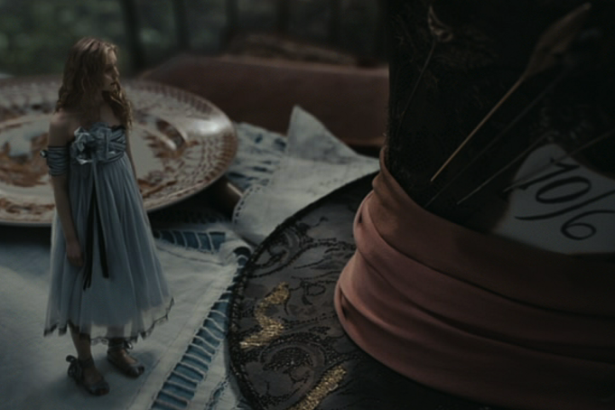
Potential Problems
Floor/ceiling effects.
Measurement range
must be appropriate.

Slide 23
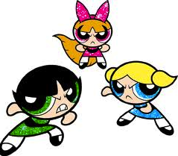
Power
What is power?
The ability to statistically detect a trend.
What can affect the power of an experiment?
Sample Size
Strength of Signal

Slide 24
Power
Sample size.
n = (σ²z²_{α/2})/D²
σ = estimate of population standard deviation.
α = level of statistical significance.
D = maximum acceptable difference between the sample and true mean.

Slide 25
